Slide 1
Chapter 12
Food as Fuel—An Overview of Metabolism
How Metabolism Works
Metabolically Relevant Nucleotides
Digestion—From Food Molecules to Hydrolysis Products
Glycolysis—From Hydrolysis Products to Common Metabolites
The Citric Acid Cycle—Central Processing
Electron Transport and Oxidative Phosphorylation
ATP Production

Slide 2
Metabolism
Metabolism involves
  all chemical reactions that provide energy and substances needed for growth
  catabolic reactions that break down large, complex molecules to provide energy and smaller molecules
  anabolic reactions that use ATP energy to build larger molecules
Metabolites are chemical intermediates formed by enzyme-catalyzed reactions in the body.

Slide 3
Stages of Metabolism
Catabolic reactions are organized in stages.
Stage 1: Digestion and hydrolysis break down large molecules to smaller
ones that enter the bloodstream.
Stage 2: Degradation breaks down molecules to
two- and three-carbon compounds
Stage 3: Oxidation of small molecules in the citric
  acid cycle and electron transport provides
  ATP energy.

Slide 4
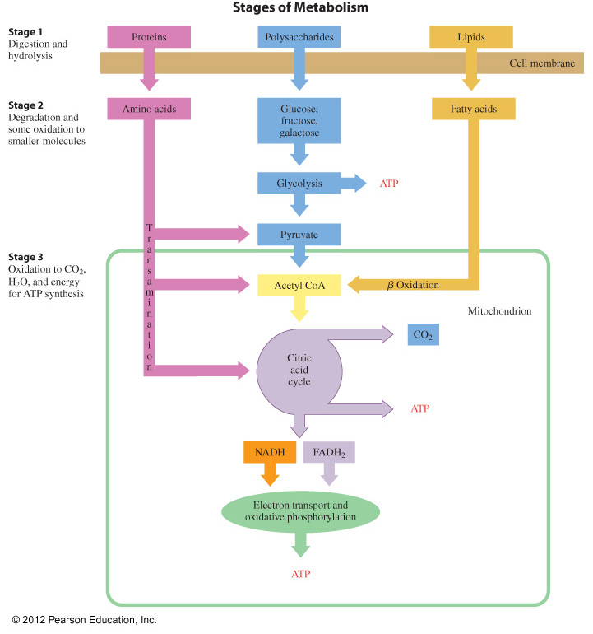
Stages of Metabolism

Slide 5
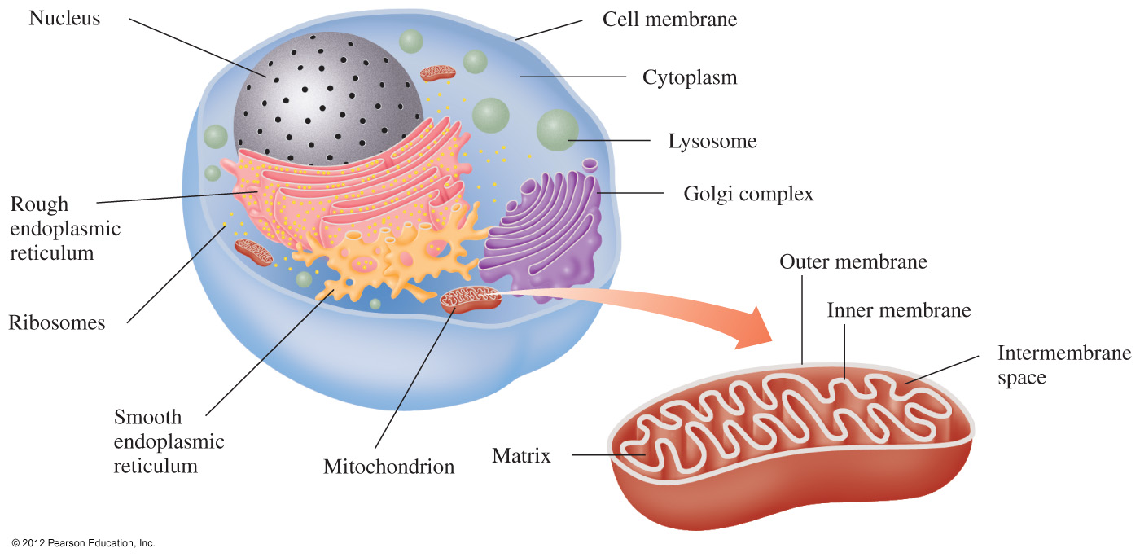
Cell Structure and Metabolism

Slide 6
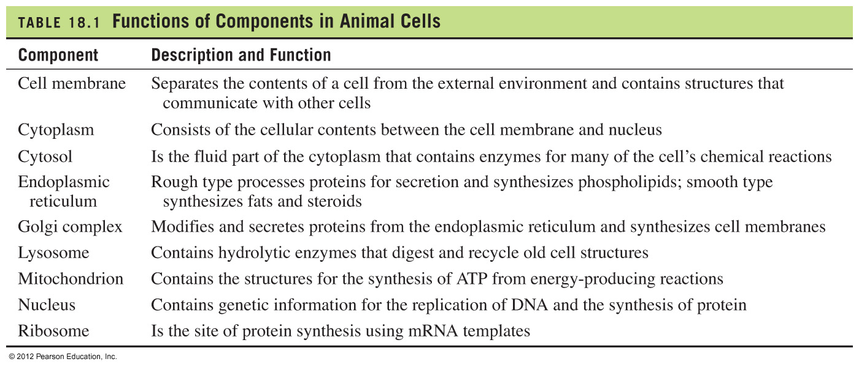
Cell Components and Function
Insert Table 18.1 pg 636.

Slide 7
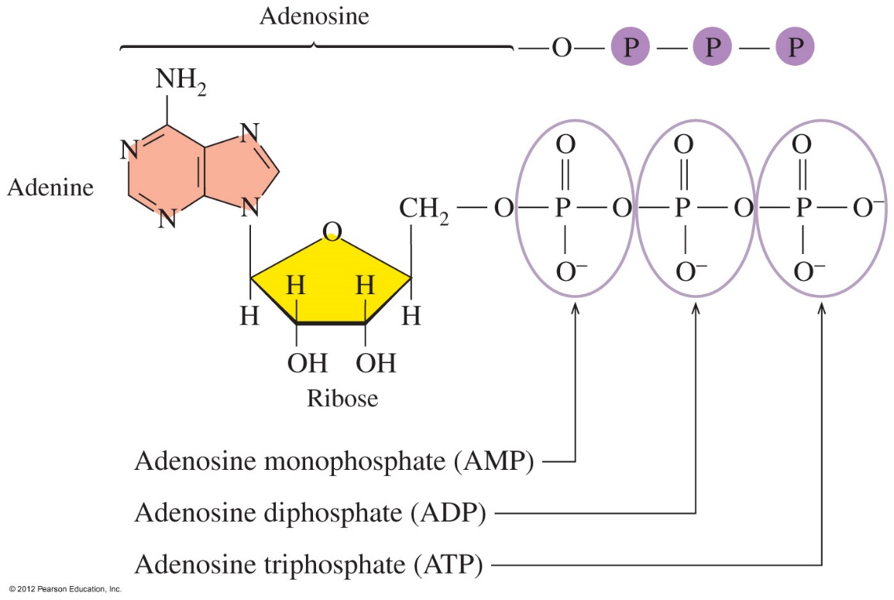
ATP and Energy
In the body, energy is stored as adenosine triphosphate (ATP).

Slide 8
Hydrolysis of ATP
Every time we contract muscles, move substances across cellular membranes, send nerve signals, or synthesize an enzyme, we use energy from ATP hydrolysis.
The hydrolysis of ATP to ADP releases 7.3 kcal.
ATP ADP + P_{i} + 7.3 kcal/mole
ADP AMP + P_{i} + 7.3 kcal/mole

Slide 9
Learning Check
Classify each of the following as ATP or ADP + P_{i}.
A. used in anabolic reactions
B. the energy-storage molecule
C. coupled with energy-requiring reactions
D. hydrolysis products

Slide 10
Solution
Classify each of the following as ATP or ADP + P_{i}.
A. used in anabolic reactions ATP
B. the energy-storage molecule ATP
C. coupled with energy-requiring reactions ATP
D. hydrolysis products ADP + P_{i}

Slide 11
Stage 1: Digestion of Carbohydrates
In stage 1,
carbohydrates begin digestion in the mouth
α-glycosidic bonds in amylose and amylopectin are hydrolyzed by enzymes released from salivary glands
smaller polysaccharides such as dextrins, maltose, and glucose are produced

Slide 12
Stage 1: Digestion of Carbohydrates
In stage 1,
digestion continues in the small intestine, where enzymes hydrolyze dextrins to maltose and glucose
maltose, lactose, and sucrose are hydrolyzed to monosaccharides, mostly glucose, which enter the bloodstream for transport to the cells

Slide 13
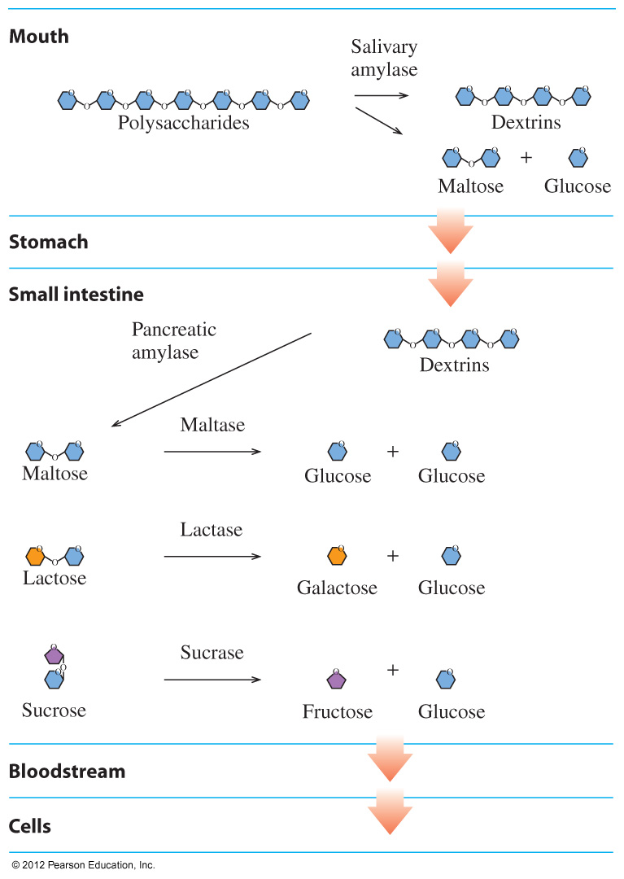
Carbohydrate Digestion

Slide 14
Digestion of Fats
In stage 1, the digestion of fats (triacylglycerols)
begins in the small intestine, where bile salts break fat globules into smaller particles called micelles
requires enzymes from pancreas to hydrolyze triacylglycerols to yield monoacylglycerols and fatty acids absorbed by intestinal lining
Once across the intestinal wall, free fatty acids and monoglycerides are reassembled as triglycerides while the cholesterol is linked to another free fatty acid forming a cholesterol ester. These are repackaged as a lipoprotein called a chylomicron.
Chylomicrons transport triglycerides to the tissues, where they are used for energy production
or stored.

Slide 15
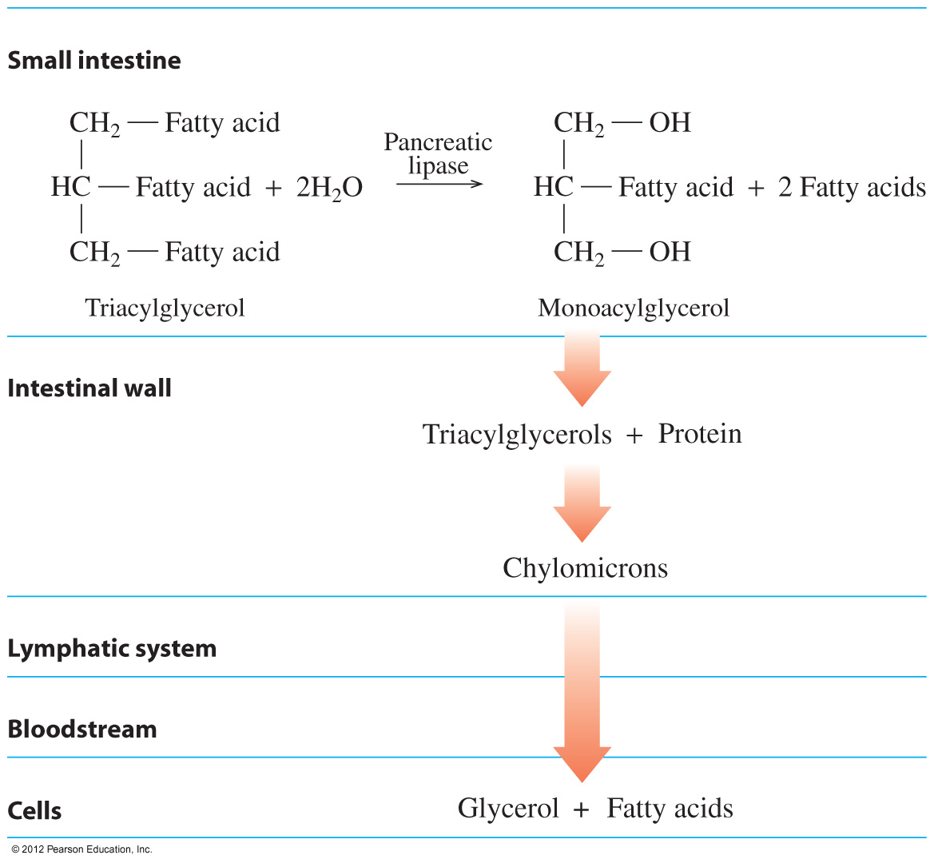
Digestion of Triacylglycerols

Slide 16
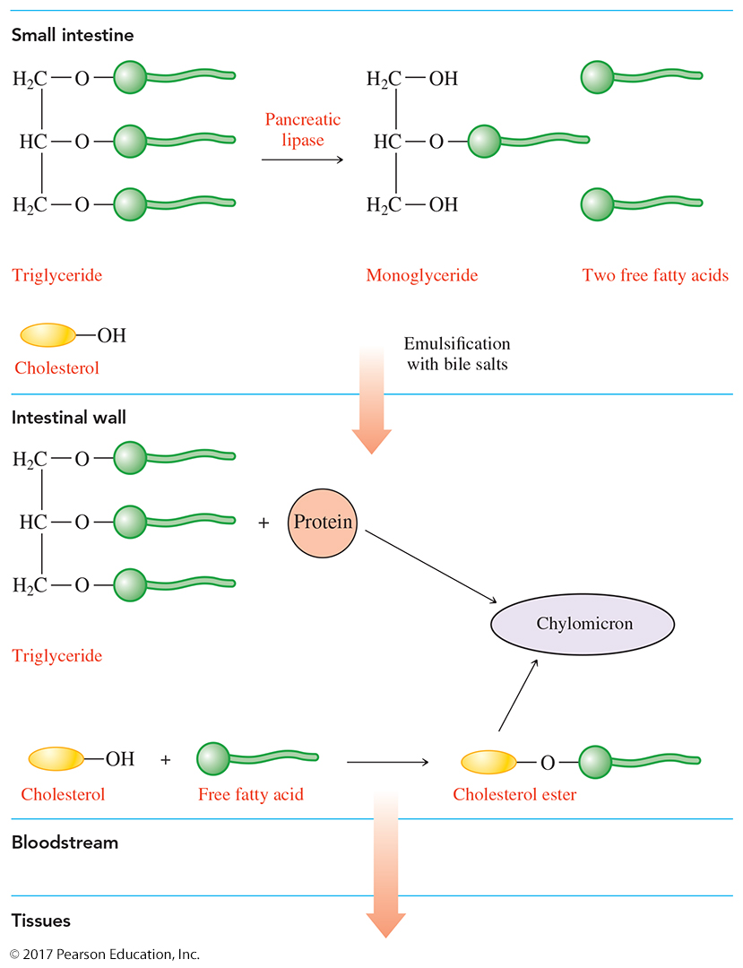

Slide 17
Digestion of Proteins
In stage 1, the digestion of proteins
begins in the stomach, where HCl in stomach acid denatures proteins and activates enzymes to hydrolyze peptide bonds
continues in the small intestine, where smaller proteins are completely hydrolyzed to amino acids
ends as amino acids enter the bloodstream for transport
to cells

Slide 18
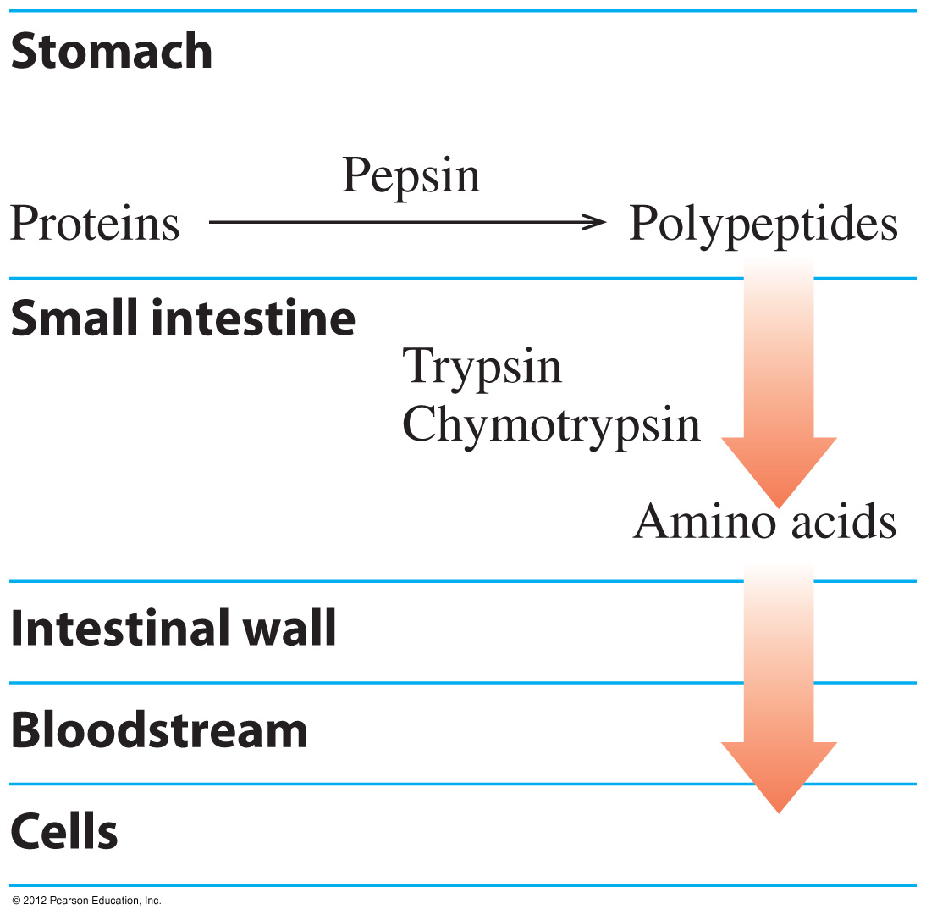
Digestion of Proteins

Slide 19
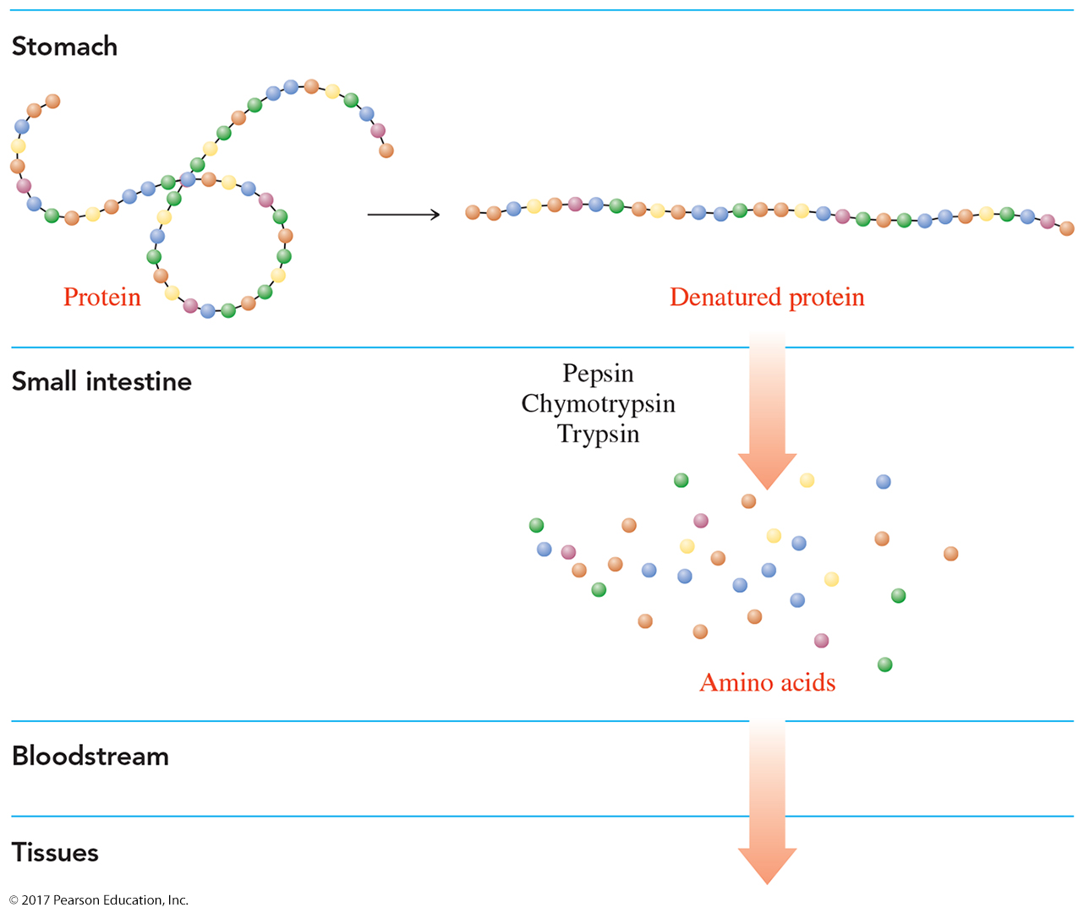

Slide 20
Learning Check
Match the end products of digestion, amino acids, fatty acids and glycerol, or glucose, with the types of food.
A. fats
B. proteins
C. carbohydrates

Slide 21
Solution
Match the end products of digestion, amino acids, fatty acids and glycerol, or glucose, with the types of food.
A. fats fatty acids and glycerol
B. proteins amino acids
C. carbohydrates glucose

Slide 22
Oxidation and Reduction
To extract energy from foods,
oxidation reactions
involve a loss of 2 H (2H⁺ and 2 e–) or gain of oxygen
compound oxidized compound + 2H
reduction reactions
require coenzymes that pick up 2 H or loss of oxygen
coenzyme + 2H reduced coenzyme

Slide 23
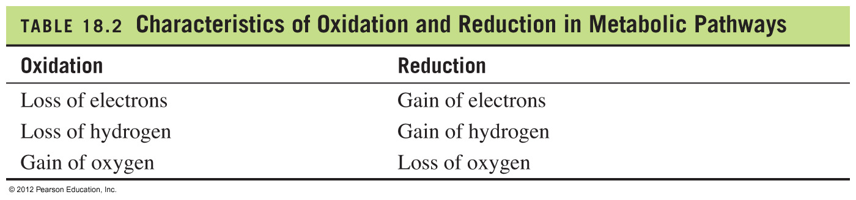
Metabolic Pathways:
Oxidation and Reduction

Slide 24
Coenzyme NAD⁺
NAD⁺ (nicotinamide adenine dinucleotide)
is an important coenzyme in which the B₃ vitamin niacin provides the nicotinamide group, which is bonded to ADP
participates in reactions that produce a carbon-oxygen double bond (C=O)
is reduced when an oxidation provides 2H⁺ and 2 e–
Oxidation O
||
CH₃—CH₂—OH CH₃—C—H + 2H⁺ + 2 e–
Reduction
NAD⁺ + 2H⁺ + 2 e– NADH + H⁺

Slide 25
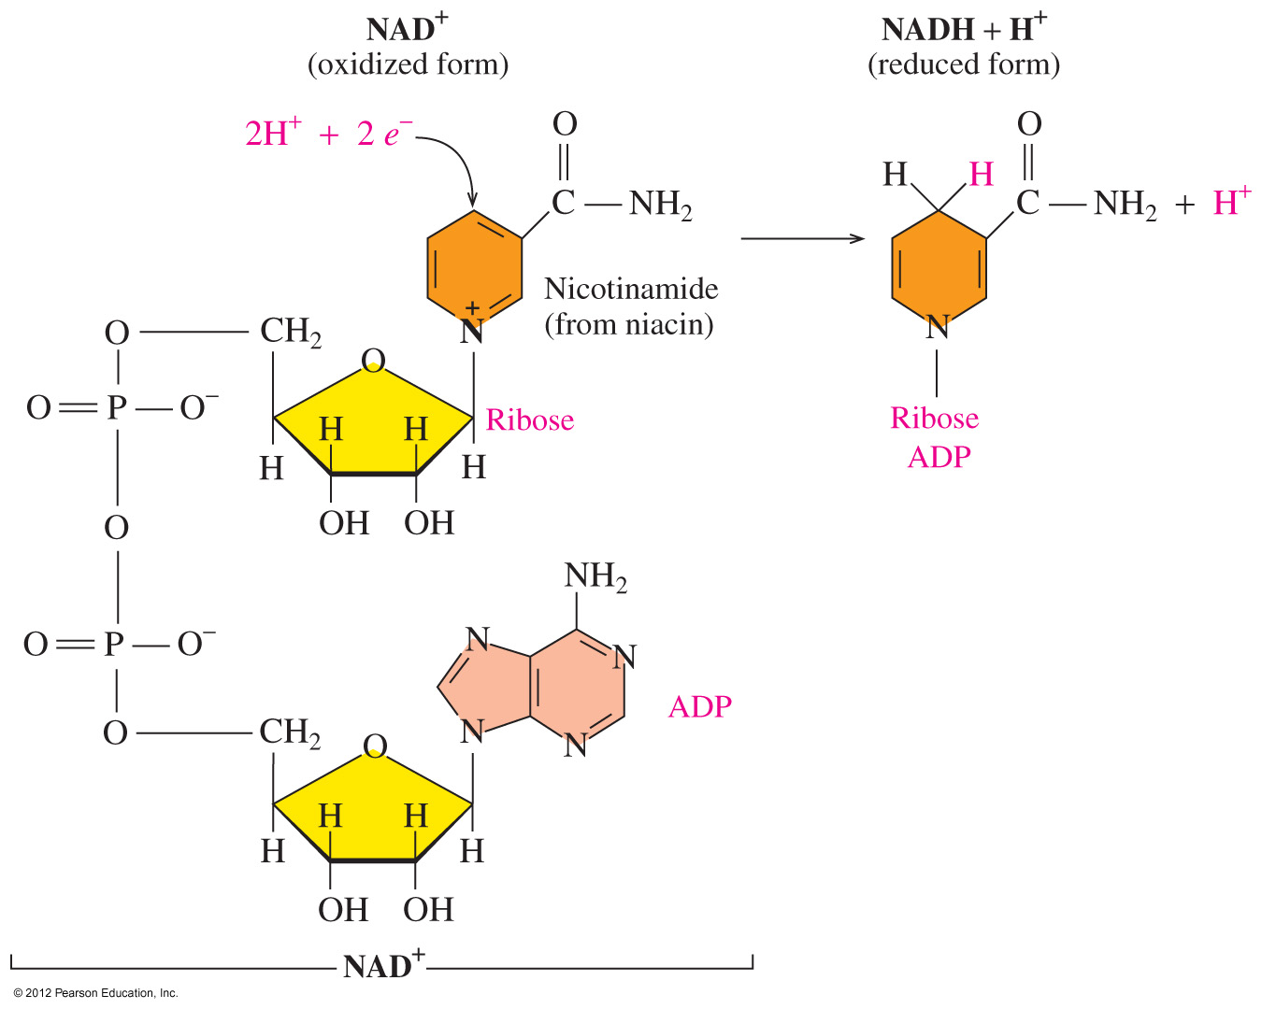
Structure of Coenzyme NAD⁺
NAD⁺
contains ADP, ribose, and nicotinamide
is reduced to NADH when NAD⁺ accepts 2H⁺ and 2 e⁻

Slide 26
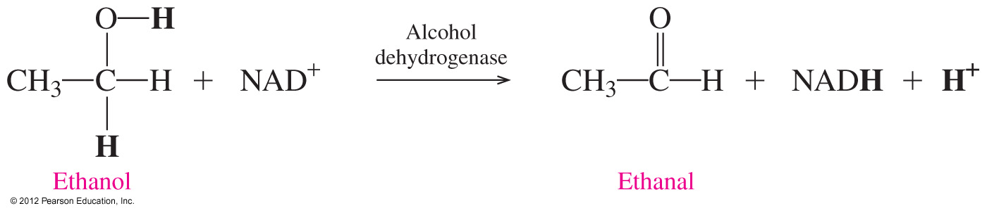
NAD⁺ Participates in Oxidation
An example of an oxidation–reduction reaction that utilizes NAD⁺ is the oxidation of ethanol in the liver to ethanal and NADH.

Slide 27
Coenzyme FAD
FAD (flavin adenine dinucleotide)
participates in reactions that produce a carbon–carbon double bond (C=C)
is reduced to FADH₂
Oxidation
—CH₂—CH₂— —CH=CH— + 2H⁺ + 2 e–
Reduction
FAD + 2H⁺ + 2 e– FADH₂

Slide 28
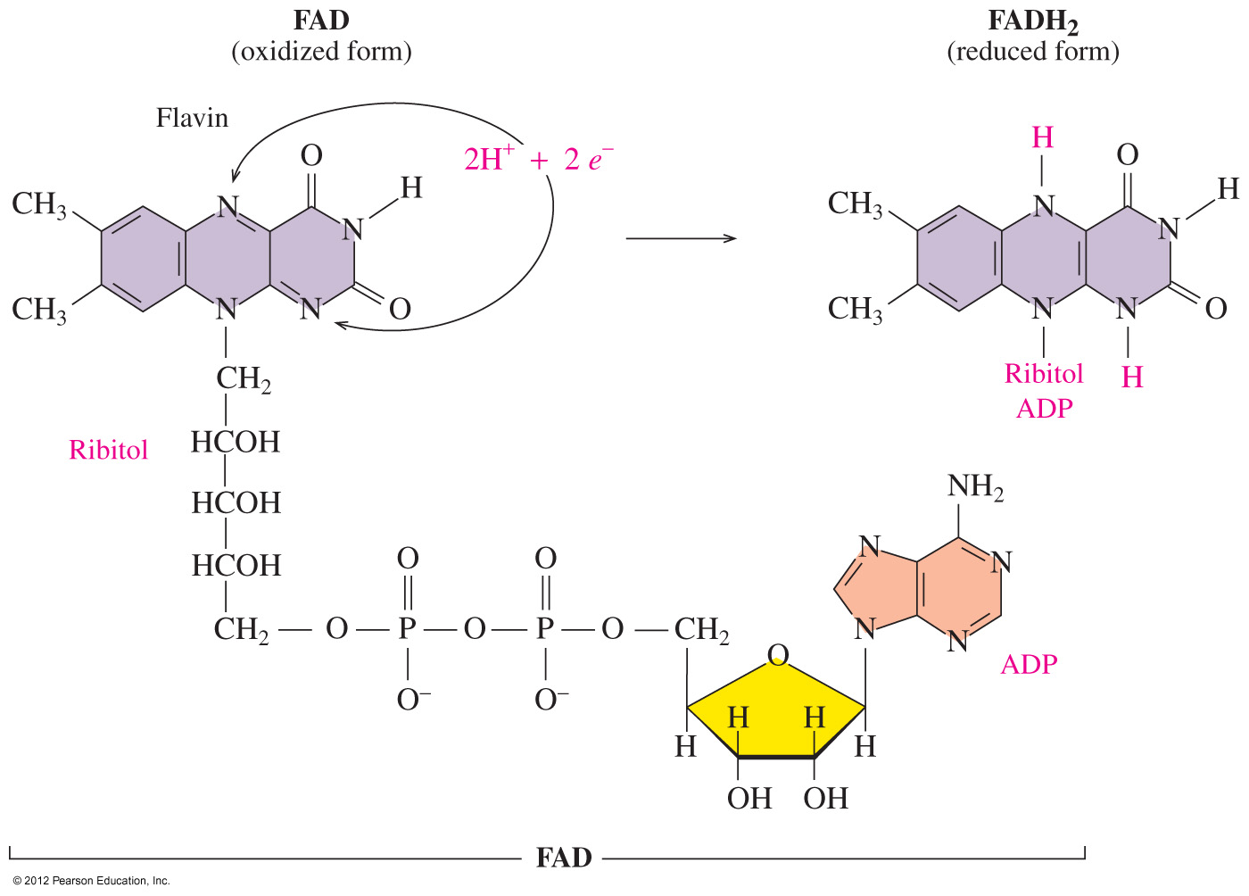
Structure of Coenzyme FAD
FAD (flavin adenine
dinucleotide)
contains ADP and riboflavin
(vitamin B₂)
is reduced to FADH₂ when flavin accepts
2H⁺ and 2 e–

Slide 29
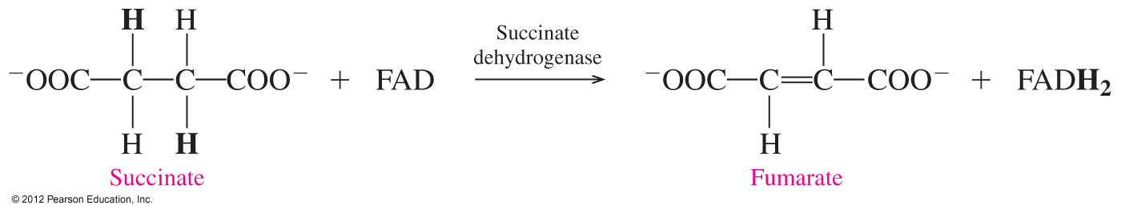
Structure of Coenzyme FAD
An example of a reaction in the citric acid cycle that utilizes FAD is the conversion of the carbon–carbon single bond in succinate to a double bond in fumarate and FADH₂.

Slide 30
Coenzyme A
Coenzyme A (CoA) activates acyl groups such as the two carbon acetyl group for transfer.
O O
|| ||
CH₃—C— + HS—CoA CH₃—C—S—CoA
Acetyl group Acetyl CoA

Slide 31
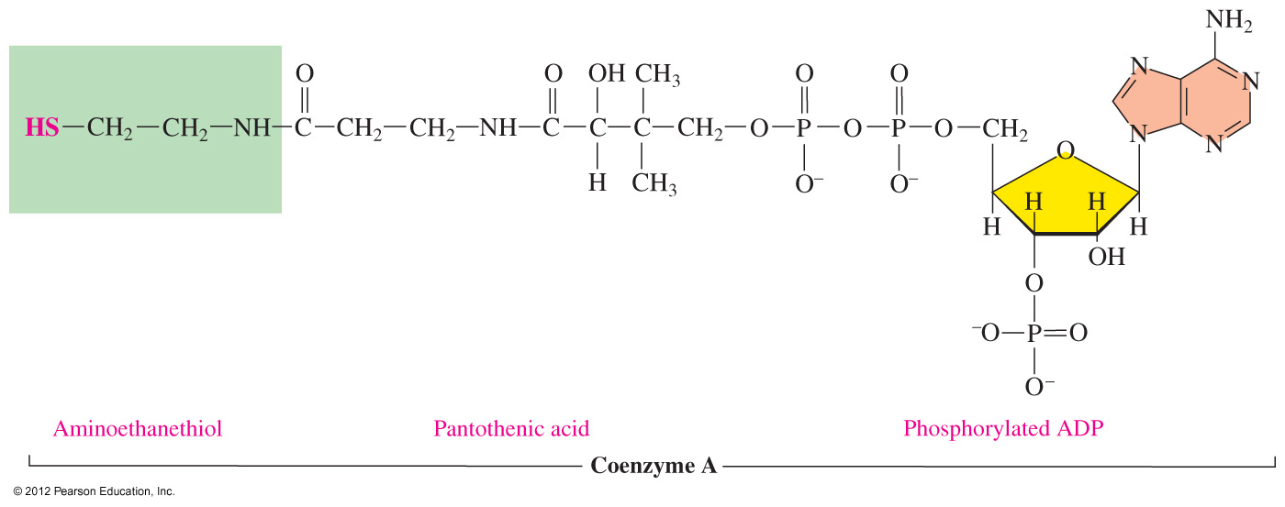
Structure of Coenzyme A
Coenzyme A (CoA) contains pantothenic acid (vitamin B₅), ADP, and aminoethanethiol.

Slide 32
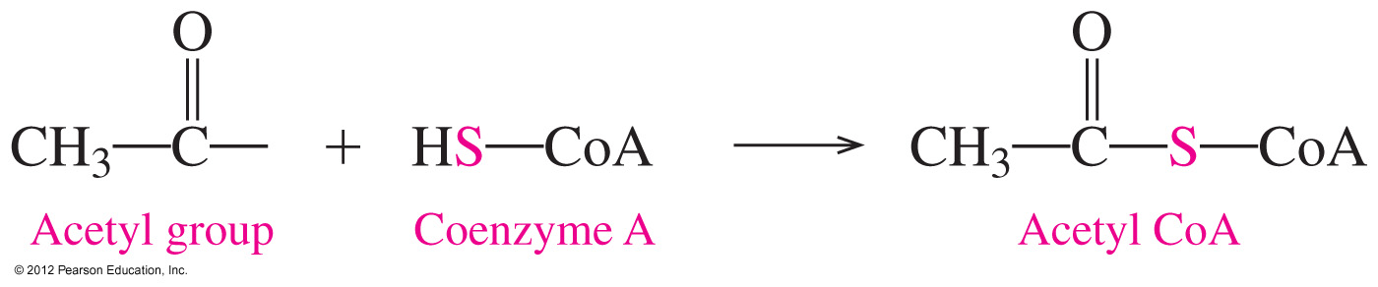
Coenzyme A: Synthesis of Acetyl CoA
The important feature of coenzyme A (abbreviated HS-CoA) is the thiol group, which bonds to two-carbon acetyl groups to give the energy-rich thioester acetyl CoA.

Slide 33
Learning Check
Which of the following coenzymes best match with the description?
NAD⁺ FAD NADH + H⁺
FADH₂ Coenzyme A
A. coenzyme used in oxidation of carbon–oxygen bonds
B. reduced form of flavin adenine dinucleotide
C. used to transfer acetyl groups
D. oxidized form of flavin adenine dinucleotide
E. the coenzyme after C=O bond formation

Slide 34
Solution
Which of the following coenzymes best match with the description?
NAD⁺ FAD NADH + H⁺
FADH₂ Coenzyme A
A. coenzyme used in oxidation of carbon-oxygen bonds NAD⁺
B. reduced form of flavin adenine dinucleotide FADH₂
C. used to transfer acetyl groups Coenzyme A
D. oxidized form of flavin adenine dinucleotide FAD
E. the coenzyme after C=O bond formation NADH + H⁺

Slide 35
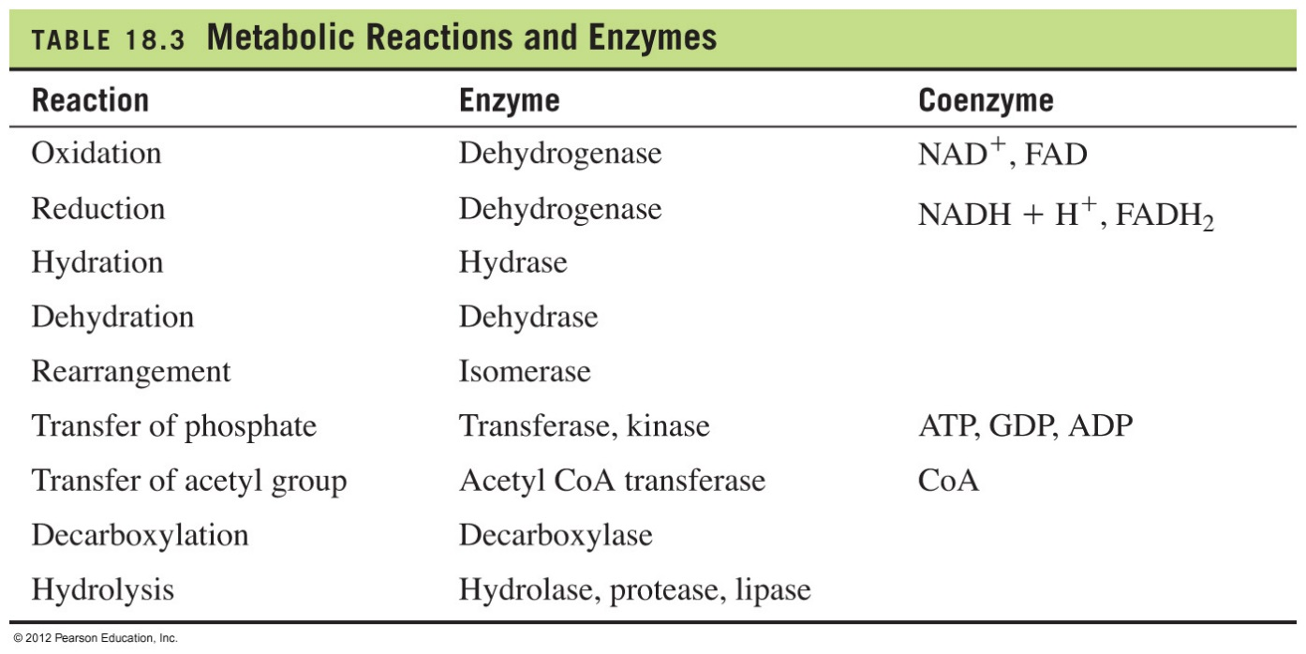
Types of Metabolic Reactions
Metabolic reactions take place at body temperature and physiological pH, which requires enzymes and often coenzymes.

Slide 36
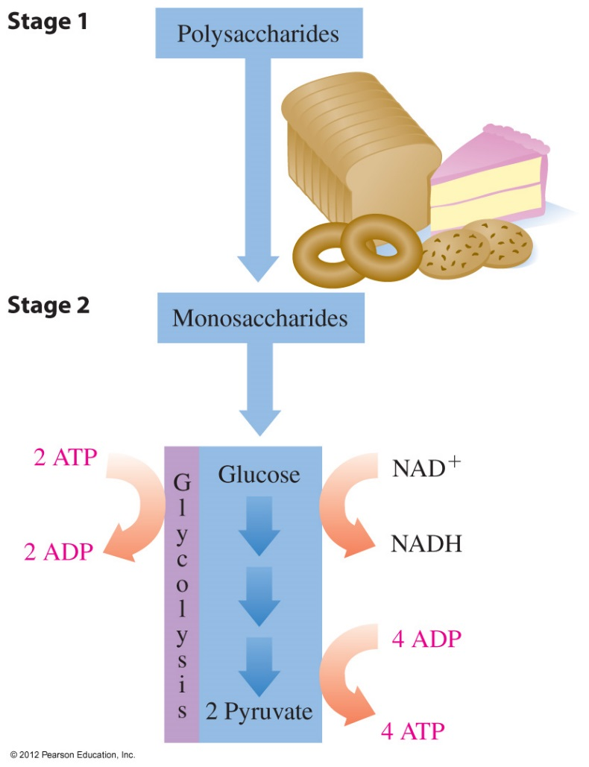
Stage 2: Glycolysis
Stage 2: Glycolysis
is a metabolic pathway that uses glucose, a digestion product from carbohydrates
degrades six-carbon glucose molecules to
three-carbon pyruvate molecules
is an anaerobic (no oxygen) process

Slide 37
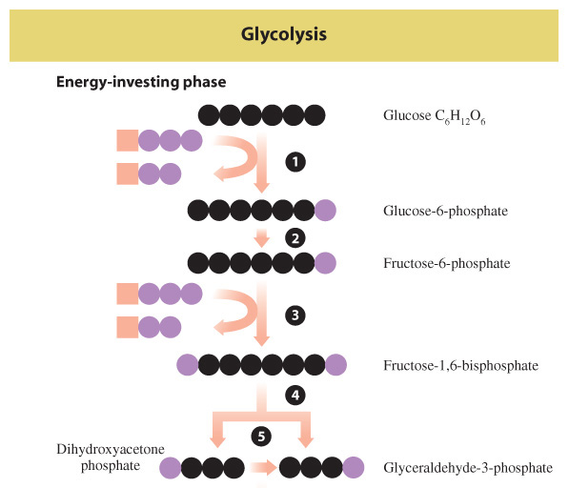
Glycolysis: Energy Investment
In reactions 1 to 5 of glycolysis,
energy is required to add phosphate groups to glucose
glucose is converted to two three-carbon molecules

Slide 38
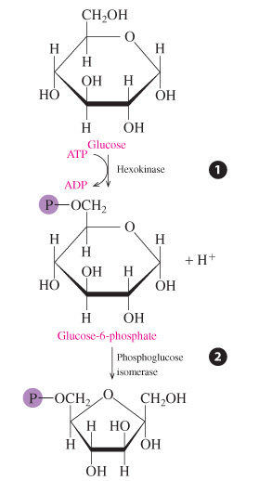
Glycolysis: Energy Investment
Reaction 1 Phosphorylation
A phosphate from ATP is added to glucose, forming glucose-6-phosphate and ADP.
Reaction 2 Isomerization
The glucose-6-phosphate, the aldose from reaction 1, undergoes isomerization to fructose-6-phosphate, which is a ketose.

Slide 39
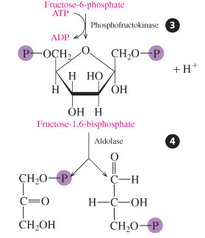
Glycolysis: Energy Investment
Reaction 3 Phosphorylation
Fructose-6-phosphate reacts with a second ATP, adding a second phosphate to the molecule: fructose-1,6-biphosphate.
Reaction 4 Cleavage
Fructose-1,6-bisphosphate is split into two three-carbon phosphate isomers:
dihydroxyacetone phosphate and glyceraldehyde-3-phosphate.

Slide 40
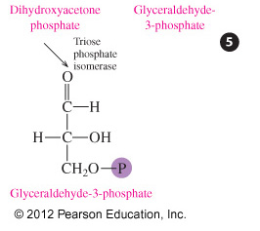
Glycolysis: Energy Investment
Reaction 5 Isomerization
Because dihydroxyacetone phosphate is a ketone, it cannot react further. It undergoes isomerization to provide a second molecule of glyceraldehyde-3-phosphate,
which can be oxidized. Now all six-carbon atoms from glucose are contained
in two identical triose phosphates.

Slide 41
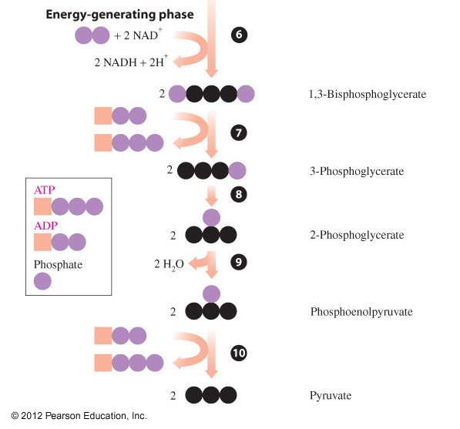
Glycolysis: Energy Production
In reactions 6 to 10 of glycolysis, energy is generated as
sugar phosphates are cleaved to triose phosphates
four ATP molecules are produced

Slide 42
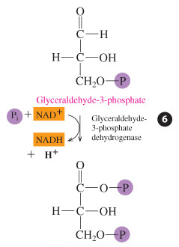
Glycolysis: Energy Production
Reaction 6
Oxidation, Phosphorylation
The aldehyde group of each glyceraldehyde-3-phosphate is oxidized to a carboxyl group by the coenzyme, which is reduced to NADH and H⁺. A phosphate adds to the new carboxyl groups to form two molecules of the high-energy compound 1,3-bisphosphoglycerate.

Slide 43
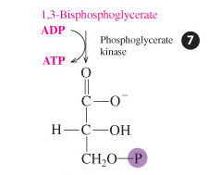
Glycolysis: Energy Production
Reaction 7 Phosphate Transfer
Phosphorylation transfers a phosphate group from each 1,3-bisphosphoglycerate to ADP, producing 2 molecules of ATP. At this point 2 ATPs are produced, balancing the two ATPs consumed in reactions 1 and 3.

Slide 44
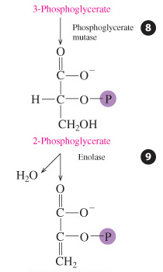
Glycolysis: Energy Production
Reaction 8 Isomerization
Two 3-phosphoglycerate molecules isomerize, moving the phosphate group from carbon 3 to carbon 2 and yielding two 2-phosphoglycerates.
Reaction 9 Dehydration
Each phosphoglycerate undergoes dehydration to give two high-energy molecules of phosphoenolpyruvate.

Slide 45
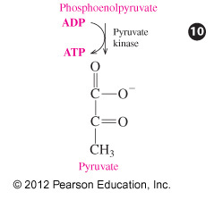
Glycolysis: Energy Production
Reaction 10 Phosphate Transfer
In a second direct phosphate transfer, phosphate groups from two phosphoenolpyruvate are transferred to 2 ADPs, forming 2 pyruvates and 2 ATPs.

Slide 46
Glycolysis: Overall Reaction
In glycolysis,
two ATP add phosphate to glucose and fructose-6-phosphate
four ATP form as phosphate groups add to ADP
there is a net gain of 2 ATP and 2 NADH
C₆H₁₂O₆ + 2ADP + 2P_{i} + 2NAD⁺
Glucose
2C₃H₃O₃– + 2ATP + 2NADH + 4H⁺
Pyruvate

Slide 47
Regulation of Glycolysis
The main step of regulation in glycolysis is step 3.
The enzyme phosphofructokinase, which catalyzes the phosphorylation of fructose-6-phosphate to fructose-1,6-bisphosphate, is heavily regulated by
the cells.
ATP acts as an inhibitor of phosphofructokinase.
If cells have plenty of ATP, glycolysis slows down.

Slide 48
Learning Check
In glycolysis, what compounds provide phosphate groups for the production of ATP?

Slide 49
Solution
In glycolysis, what compounds provide phosphate groups for the production of ATP?
In reaction 7, phosphate groups from two
1,3-bisphosphoglycerate molecules are transferred to ADP to form 2 ATP.
In reaction 10, phosphate groups from two phosphoenolpyruvate molecules are used to form 2 more ATP.

Slide 50
Pyruvate: Aerobic Conditions
Under aerobic conditions (oxygen present),
three-carbon pyruvate is decarboxylated
two-carbon acetyl CoA and CO₂ are produced
O O Pyruvate
|| || dehydrogenase
CH₃—C—C—O⁻ + HS—CoA + NAD⁺
Pyruvate
O
||
CH₃—C—S—CoA + CO₂ + NADH
Acetyl CoA

Slide 51
Pyruvate: Anaerobic Conditions
Under anaerobic conditions (without oxygen),
pyruvate is reduced to lactate
NADH oxidizes to NAD⁺, allowing glycolysis to continue
O O Lactate
|| || dehydrogenase
CH₃—C—C—O– + NADH + H⁺
Pyruvate
OH O
| ||
CH₃—CH—C—O– + NAD⁺
Lactate

Slide 52
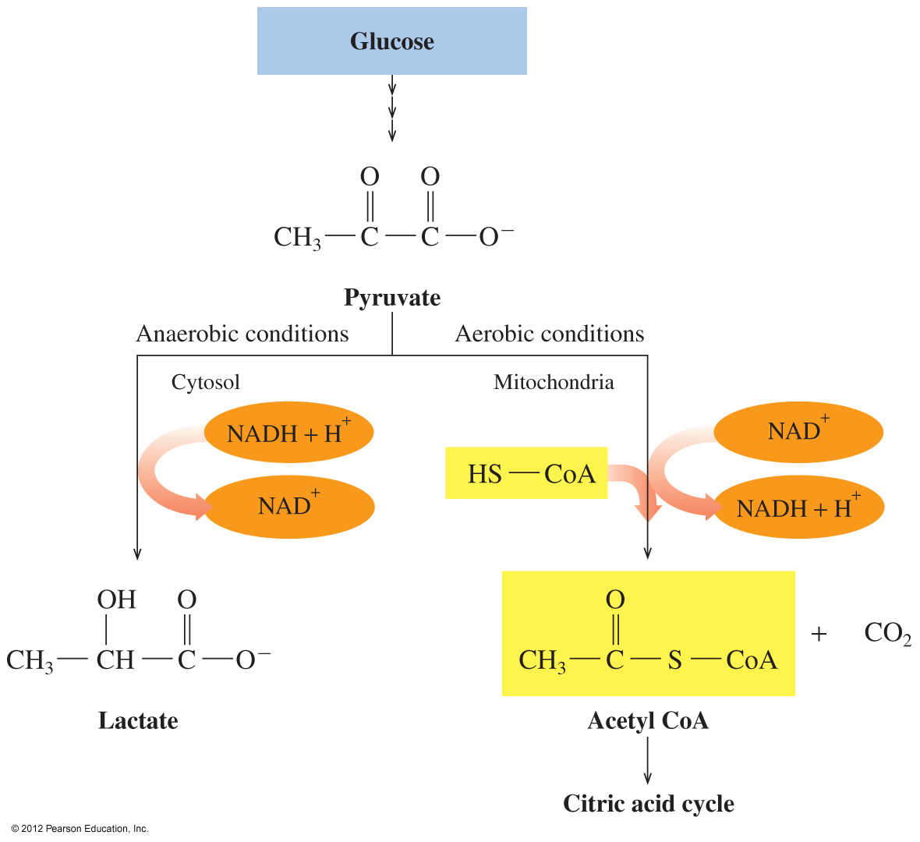
Pyruvate Pathways, Aerobic and Anaerobic
Pyruvate is converted to acetyl CoA under aerobic conditions and to lactate under anaerobic conditions.

Slide 53
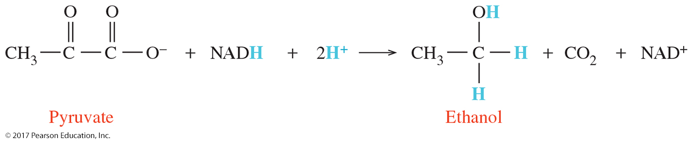
Glycolysis—From Hydrolysis Products to Common Metabolites
Yeast converts pyruvate to ethanol under anaerobic conditions.
This process is called fermentation.
In the preparation of alcoholic beverages, yeast produces pyruvate from glucose in grape juices and under low-oxygen conditions transforms pyruvate into ethanol.

Slide 54
Lactate in Muscles
During strenuous exercise,
oxygen is depleted and anaerobic conditions are produced in muscles.
under anaerobic conditions pyruvate is converted to lactate
NAD⁺ is produced and used to oxidize more glyceraldehyde-3-phosphate (glycolysis), producing small amounts of ATP
increased amount of lactate causes muscles to become tired and sore
After exercise, a person breathes heavily to repay the
oxygen debt and reform pyruvate in the liver.

Slide 55
Learning Check
Match the following terms with the descriptions.
catabolic reactions coenzymes
glycolysis lactate
A. produced during anaerobic conditions
B. reaction series that converts glucose to pyruvate
C. metabolic reactions that break down large molecules to smaller molecules + energy
D. substances that remove or add H atoms in oxidation and reduction reactions

Slide 56
Solution
Match the following terms with the descriptions.
catabolic reactions coenzymes
glycolysis lactate
A. produced during anaerobic conditions
lactate
B. reaction series that converts glucose to pyruvate
glycolysis
C. metabolic reactions that break down large molecules to smaller
molecules + energy catabolic reactions
D. substances that remove or add H atoms in oxidation and
reduction reactions coenzymes

Slide 57
Citric Acid Cycle
In stage 3 of catabolism, the citric acid cycle
is a series of reactions
connects the intermediate acetyl CoA from the metabolic pathways in stages 1 and 2 with electron transport and the synthesis of ATP in stage 3
operates under aerobic conditions only
oxidizes the two-carbon acetyl group in acetyl CoA to 2CO₂
produces reduced coenzymes NADH and FADH₂ and one ATP directly

Slide 58
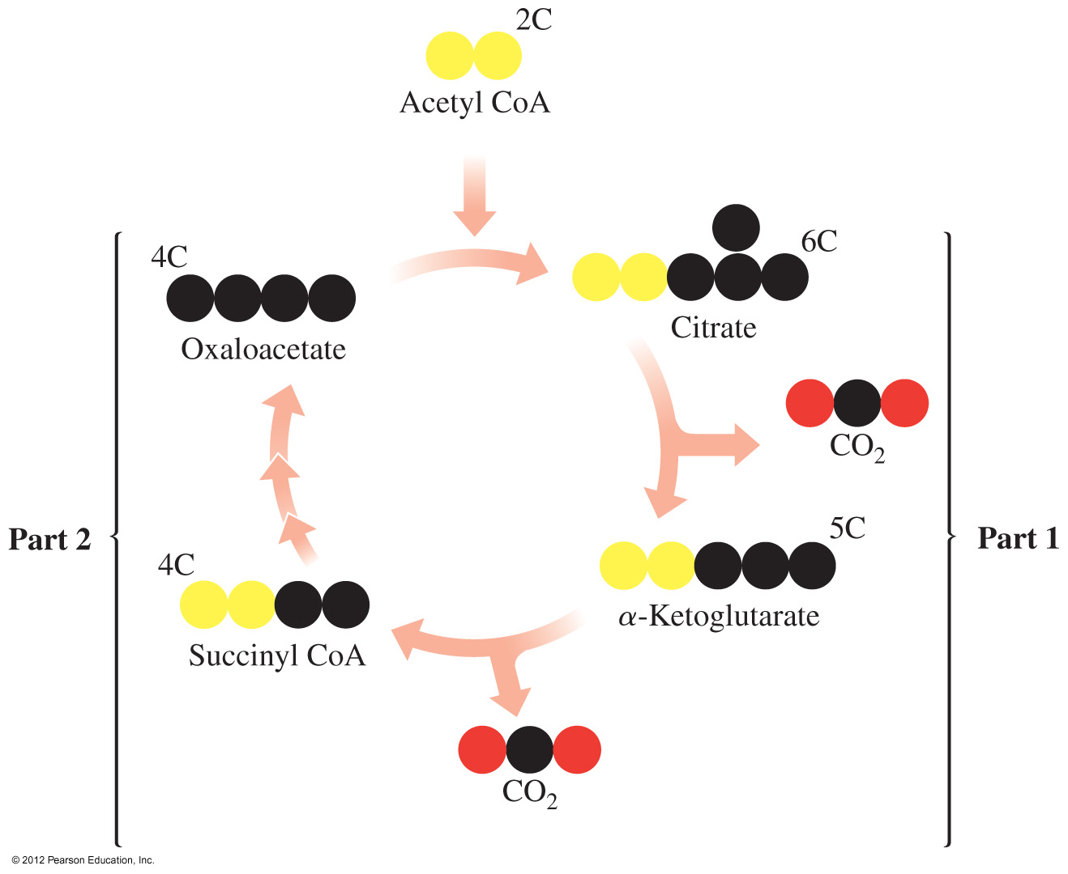
Citric Acid Cycle Overview
In the citric acid cycle,
an acetyl group (2C) in acetyl CoA bonds to oxaloacetate (4C) to form citrate (6C)
oxidation and decarboxylation reactions convert citrate to oxaloacetate
oxaloacetate bonds with another acetyl to repeat the cycle

Slide 59
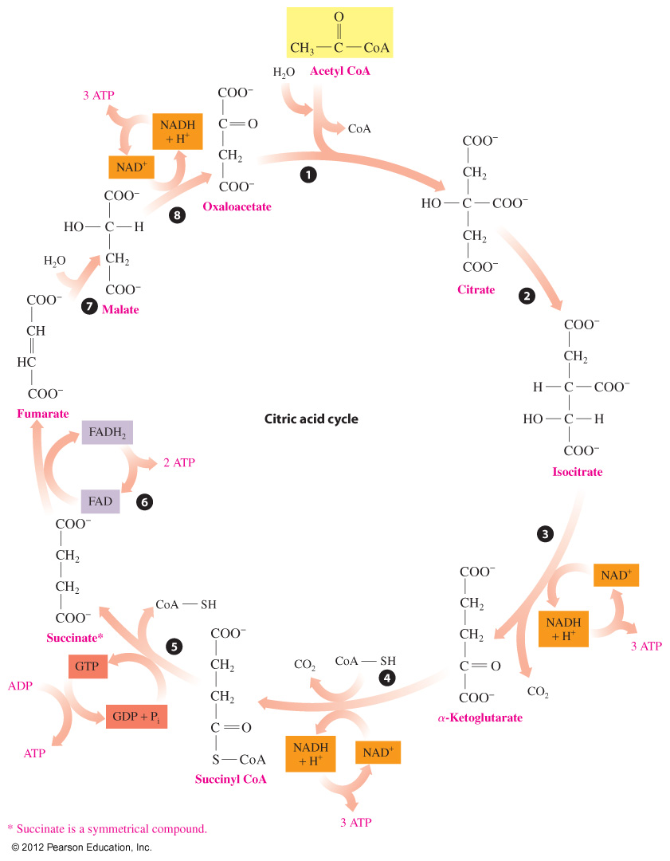
Citric Acid
Cycle

Slide 60
Reaction 1: Formation of Citrate
Oxaloacetate combines with the two-carbon acetyl group to form citrate.
C
O
O
–
C
O
O
–
O
C
H
2
C
O
C
H
C
S
C
o
A
H
O
C
C
O
O
–
3
C
H
C
H
2
2
C
O
O
–
C
O
O
–
Oxaloacetate
Acetyl CoA
Citrate

Slide 61
Reaction 2: Isomerization to Isocitrate
Citrate
isomerizes to isocitrate
converts the tertiary –OH group in citrate to a secondary –OH in isocitrate that can be oxidized
C
O
O
–
C
O
O
–
C
H
C
H
2
2
H
O
C
C
O
O
–
H
C
C
O
O
–
C
H
H
O
C
H
2
C
O
O
–
C
O
O
–
Citrate
Isocitrate

Slide 62
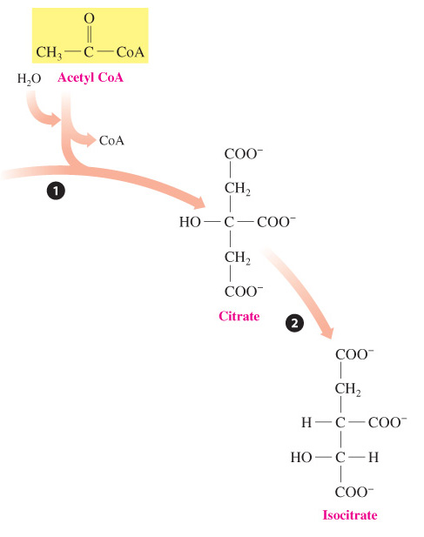
Summary of Reactions 1 and 2

Slide 63
Reaction 3: 1st Oxidative Decarboxylation
Isocitrate undergoes decarboxylation (carbon removed as CO₂),
and the –OH oxidizes to a ketone, releasing H⁺ and 2 e–
reducing the coenzyme NAD⁺ to NADH
C
O
O
–
C
O
O
–
C
H
C
H
2
NAD⁺
2
H
C
C
O
O
–
H
C
H
H
O
C
H
C
O
+
C
O
+
N
A
D
H
2
C
O
O
–
C
O
O
–
Isocitrate
α-Ketoglutarate

Slide 64
Reaction 4: 2nd Oxidative Decarboxylation
α-Ketoglutarate
undergoes decarboxylation to form succinyl CoA
produces a four-carbon compound that bonds to CoA
provides H⁺ and 2 e– to form NADH
α-Ketoglutarate Succinyl CoA
C
O
O
–
C
O
O
–
C
H
C
H
2
2
C
H
NAD⁺
C
H
+
C
O
+
N
A
D
H
2
2
2
C
O
C
O
–
CoA-SH
C
O
O
S
C
o
A

Slide 65
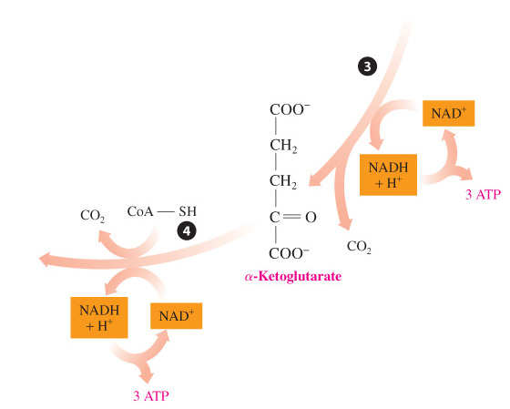
Summary of Reactions 3 and 4

Slide 66
Reaction 5: Hydrolysis
Succinyl CoA undergoes hydrolysis, adding a phosphate to GDP to form GTP, a high-energy compound.
+ GDP + P_{i}
+
+ GTP
Succinyl CoA
Succinate

Slide 67
Reaction 6: Dehydrogenation
Succinate undergoes dehydrogenation
by losing 2 H and forming a double bond
providing 2 H to reduce FAD to FADH₂
C
O
O
–
C
O
O
–
C
H
2
C
H
+ FAD
+ FADH₂
C
H
2
H
C
C
O
O
–
–
C
O
O
S
u
c
c
i
n
a
t
e
F
u
m
a
r
a
t
e

Slide 68
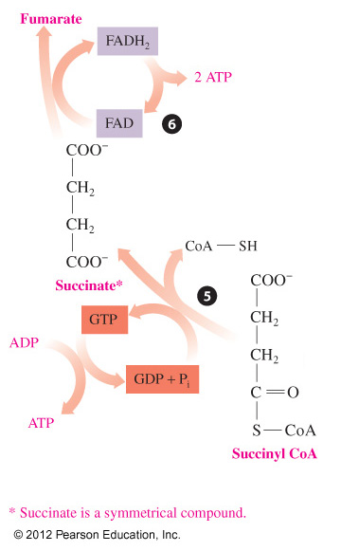
Summary of Reactions 5 and 6

Slide 69
Reaction 7: Hydration of Fumarate
Fumarate forms malate when water is added to the double bond.
C
O
O
–
–
C
O
O
C
H
H
O
C
H
H
C
+
H
O
H
C
H
2
C
O
O
–
C
O
O
–
Fumarate
Malate

Slide 70
Reaction 8: Dehydrogenation
Malate undergoes dehydrogenation
to form oxaloacetate with a C=O double bond
providing 2 H for reduction of NAD⁺ to NADH + H⁺
C
O
O
–
–
C
O
O
C
O
+
+
H
O
C
H
+ NAD⁺
N
A
D
H
H
H
C
H
C
H
2
C
O
O
–
C
O
O
–
Malate
Oxaloacetate

Slide 71
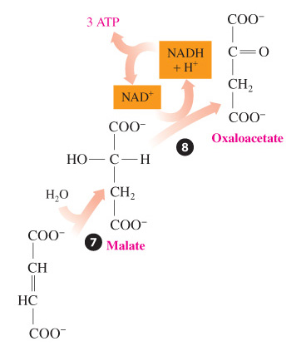
Summary of Reactions 7 and 8

Slide 72
Summary of the Citric Acid Cycle
In the citric acid cycle,
oxaloacetate bonds with an acetyl group to form citrate
two decarboxylations remove two carbons as 2CO₂
four oxidations provide hydrogen for 3 NADH and
one FADH₂
a direct phosphorylation forms GTP

Slide 73
Overall Chemical Reaction for the Citric Acid Cycle
Acetyl CoA + 3NAD⁺ + FAD + GDP + P_{i} + 2H₂O
2CO₂ + 3NADH + 2H⁺ + FADH₂ + CoA + GTP

Slide 74
Learning Check
How many of each are produced in one turn of the
citric acid cycle?
A ___ CO₂
B. ___ NADH
C. ___ FADH₂
D. ___ GTP

Slide 75
Solution
How many of each are produced in one turn of the
citric acid cycle?
A. 2 CO₂
B. 3 NADH
C. 1 FADH₂
D. 1 GTP

Slide 76
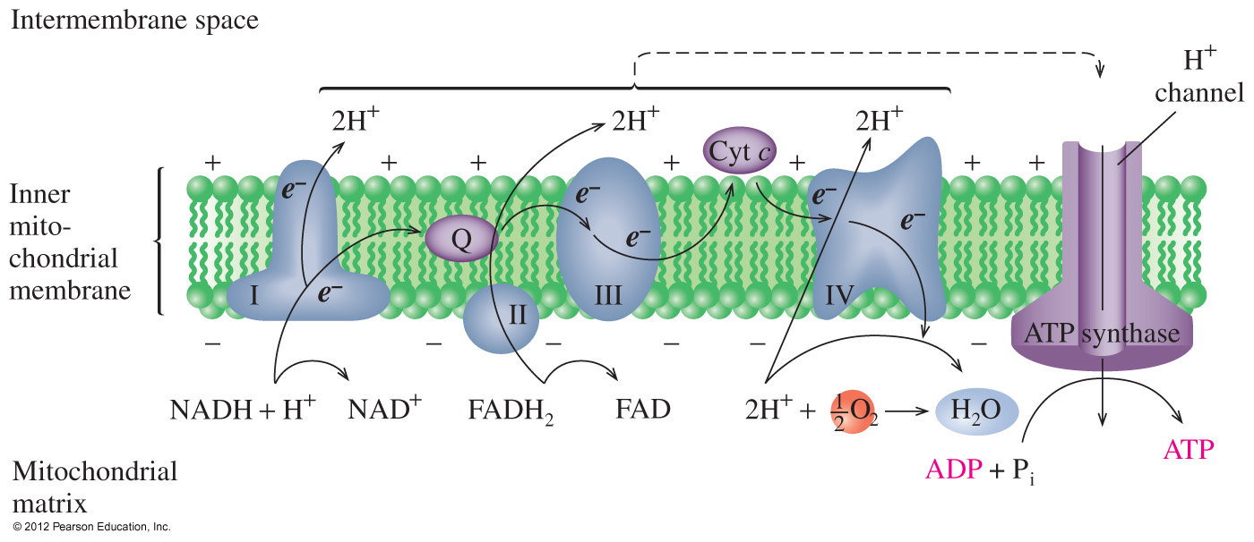
Stage 3 Electron Transport
In electron transport,
electron carriers are used
hydrogen ions and electrons from NADH and FADH₂ are passed from one electron carrier to the next and then combine with oxygen to make H₂O
are oxidized and reduced to provide energy for the synthesis of ATP from ADP and P_{i}

Slide 77
Electron Carriers
The electron transport system consists of a series of electron carriers that are
oxidized and reduced as hydrogen and/or electrons are transferred from one carrier to the next
FMN, Fe-S, coenzyme Q, and cytochromes
embedded in four enzyme complexes: I, II, III, and IV

Slide 78
Electron Transport Chain
In electron transport, coenzymes NADH and FADH₂ are oxidized in enzyme complexes, providing electrons and hydrogen ions for ATP synthesis.

Slide 79
Enzyme Complex I
NADH transfers hydrogen ions and electrons to the enzymes and electron carriers of complex I and forms the oxidized coenzyme NAD.
The hydrogen ions and electrons are transferred to the mobile electron carrier coenzyme Q (CoQ), which carries electrons to complex II.
NADH + H⁺ + Q NAD⁺ + QH₂

Slide 80
Enzyme Complex II
Enzyme complex II is used when FADH₂ is generated in the citric acid cycle from conversion of succinate to fumarate.
The hydrogen ions and electrons from FADH₂ are transferred to
coenzyme Q to yield QH₂ and the oxidized coenzyme FAD.
FADH₂ + Q FAD + QH₂

Slide 81
Enzyme Complex III
In enzyme complex III electrons from QH₂ are transferred to cytochrome c.
Cytochrome c, which contains Fe³⁺/Fe²⁺, is reduced when it gains an electron and oxidized when an electron is lost.
As a mobile carrier, cytochrome c carries electrons to
complex IV.
QH₂ + 2 cyt c (oxidized) Q + 2H⁺ + 2 cyt c (reduced)

Slide 82
Enzyme Complex IV
At enzyme complex IV electrons from cytochrome c are passed to other electron carriers until the electrons combine with hydrogen ions and oxygen (O₂) to form water.
4 e⁻ + 4H⁺ + Q₂ 2H₂O

Slide 83
Oxidative Phosphorylation
Oxidative phosphorylation is how H⁺ ions are involved in providing energy needed to produce ATP.
In the chemiosmotic model,
protons (H⁺) from complexes I, III, and IV move into the intermembrane space
protons return to matrix through ATP synthase, a protein complex providing for ATP synthesis

Slide 84
Oxidative Phosphorylation
Thus the process of oxidative phosphorylation couples the energy from electron transport to the synthesis of ATP from ADP.
ADP + P_{i} + Energy ATP
ATP synthase

Slide 85
ATP Synthesis
At complex I the energy released from its oxidation is used to synthesize three ATP molecules.
NADH + H⁺ + ½O₂ + 3ADP + 3P_{i} NAD⁺ + H₂O + 3ATP
FADH₂ + ½O₂ + 2ADP + 2P_{i} FAD + H₂O + 2ATP

Slide 86
ATP from Glycolysis
In glycolysis, the oxidation of glucose stores energy in 2 NADH and 2 ATP.
Glycolysis occurs in the cytoplasm where hydrogen ions and electrons from NADH are transferred to compounds for transport into the mitochondria.
The reaction for the shuttle is:
NADH + H⁺ + FAD NAD⁺ + FADH₂
Cytoplasm Mitochondria

Slide 87
ATP from Glycolysis
Therefore, the transfer from NADH in the cytoplasm to FADH₂ produces 2 ATPs rather than 3.
Glycolysis yields a total of 6 ATPs:
4 ATPs from 2 NADHs
2 ATPs from direct phosphorylation
Glucose 2 pyruvate + 2ATP + 2NADH ( 2FADH₂)
Glucose 2 pyruvate + 6ATP

Slide 88
ATP from Oxidation of Two Pyruvates
Under aerobic conditions,
2 pyruvates enter the mitochondria and are oxidized to 2 acetyl CoA, CO₂, and 2 NADHs.
2 NADHs enter electron transport to provide 6 ATPs
2 Pyruvate 2 Acetyl CoA + 6ATP

Slide 89
ATP from the Citric Acid Cycle
One turn of the citric acid cycle provides
3 NADH × 3 ATP = 9 ATP
1 FADH₂ × 2 ATP = 2 ATP
1 GTP × 1 ATP = 1 ATP
Total = 12 ATP
Because each glucose provides two acetyl CoA, two turns of the citric acid cycle produce 24 ATPs.
2 Acetyl CoA 4CO₂ + 24ATP (two turns of citric acid cycle)

Slide 90
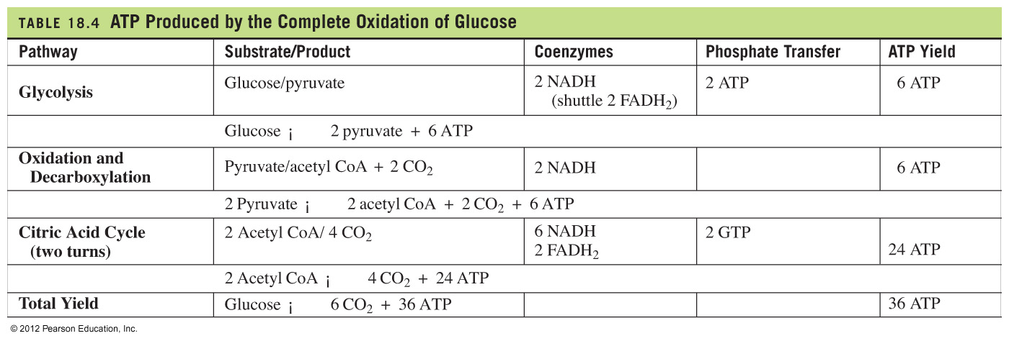
ATP from the Complete Oxidation of Glucose

Slide 91
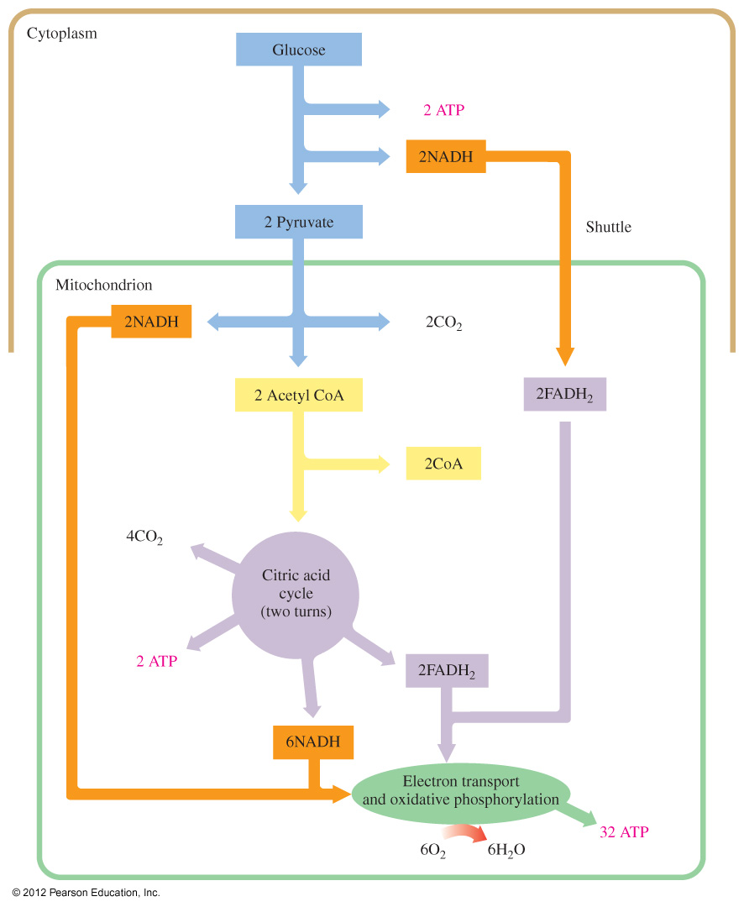
The Complete Oxidation of Glucose

Slide 92
Learning Check
Classify each as a product of the citric acid cycle or electron transport chain.
A. CO₂
B. FADH₂
C. NAD⁺
D. NADH
E. H₂O

Slide 93
Solution
Classify each as a product of the citric acid cycle or electron transport chain.
A. CO₂ citric acid cycle
B. FADH₂ citric acid cycle
C. NAD⁺ electron transport chain
D. NADH citric acid cycle
E. H₂O electron transport chain

Slide 94
Learning Check
Indicate the ATP yield for each under aerobic conditions.
A. Complete oxidation of glucose
B. FADH₂
C. Acetyl CoA in citric acid cycle
D. NADH
E. Pyruvate decarboxylation

Slide 95
Solution
Indicate the ATP yield for each under aerobic conditions.
A. Complete oxidation of glucose 36 ATPs
B. FADH₂ 2 ATPs
C. Acetyl CoA in citric acid cycle 12 ATPs
D. NADH 3 ATPs
E. Pyruvate decarboxylation 3 ATPs

Slide 96
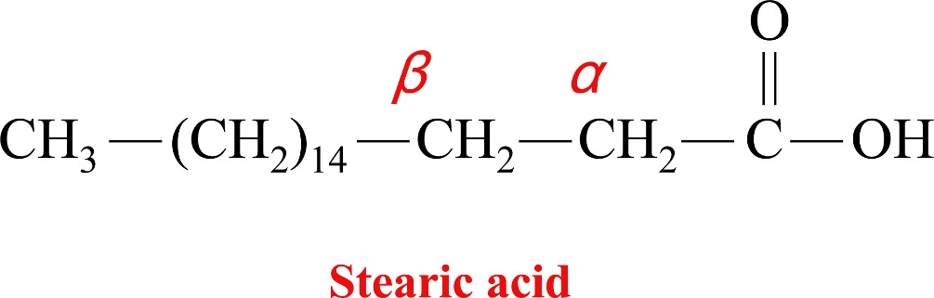
β Oxidation of Fatty Acids
In stage 2 of fat metabolism, fatty acids undergo beta oxidation, which removes two carbon segments from carbonyl end.
Each cycle in oxidation produces acetyl CoA and a fatty acid that is shorter by two carbons.

Slide 97
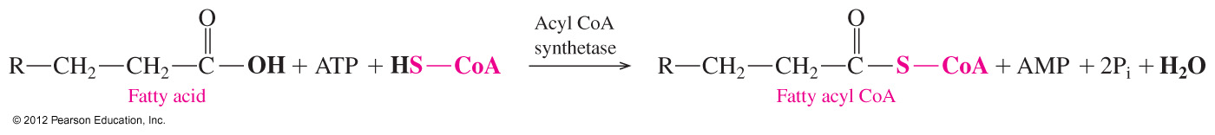
Fatty Acid Activation
Fatty acid activation
prepares them for transport through the inner membrane of mitochondria
combines a fatty acid with coenzyme A to yield fatty
acyl CoA
requires energy obtained from hydrolysis of ATP to give AMP and 2P_{i}s

Slide 98
Reactions 1 and 2 of β-Oxidation Cycle
Reaction 1 Dehydrogenation
Hydrogen atoms removed by FAD from the α and β carbons form a double bond and FADH₂.
Reaction 2 Hydration
H−OH adds across the double bond, the −OH on the β carbon.

Slide 99
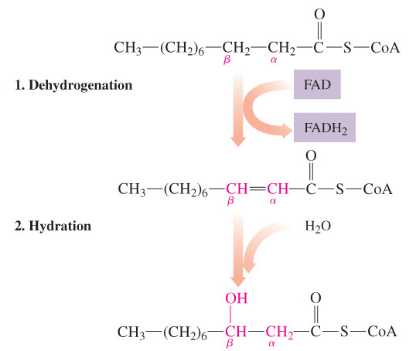
Reactions 1 and 2 of β-Oxidation Cycle

Slide 100
Reaction 3 of β-Oxidation Cycle
Reaction 3 Oxidation
The −OH on the β carbon is oxidized by NAD⁺, forming a β ketone and NADH + H⁺.

Slide 101
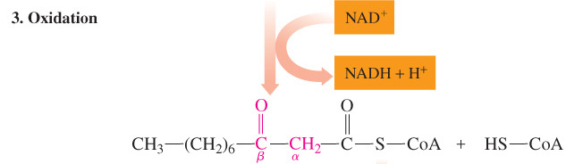
Reactions 3 of β-Oxidation Cycle

Slide 102
Reaction 4 of β-Oxidation Cycle
Reaction 4 Cleavage
The C_{α}—C_{β} is cleaved to yield acetyl CoA and a shorter (8C) fatty acyl CoA. The process is repeated until the fatty acid is completely broken down.

Slide 103
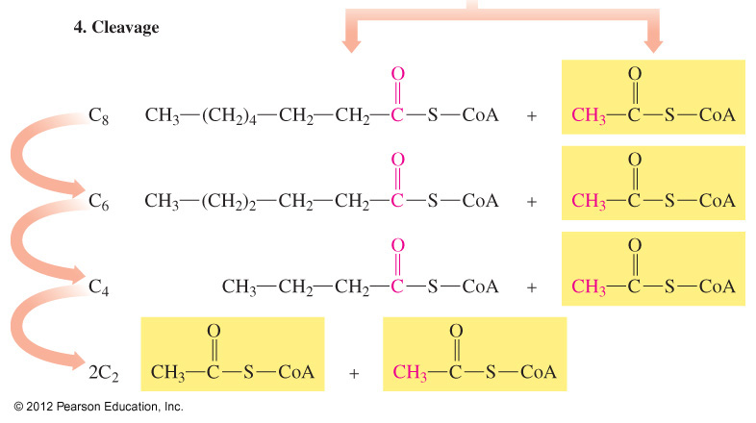
Reaction 4 of β-Oxidation Cycle

Slide 104
Learning Check
Match the reactions of β oxidation with each.
oxidation 1 hydration
oxidation 2 fatty acyl CoA cleaved
A. Water is added.
B. FADH₂ forms.
C. A two-carbon unit is removed.
D. A hydroxyl group is oxidized.
E. NADH forms.

Slide 105
Solution
Match the reactions of β oxidation with each.
oxidation 1 hydration
oxidation 2 fatty acyl CoA cleaved
A. Water is added. hydration
B. FADH₂ forms. oxidation 1
C. A two-carbon unit is removed. fatty acyl CoA cleaved
D. A hydroxyl group is oxidized. oxidation 2
E. NADH forms. oxidation 2

